Slide 1
HINDI DEPARTMENT IQAC Report : 2015 -19

Slide 2
Hindi Department is one of the oldest department
Established in 1968 started with B.A. Pass Course
1973 Hon’s Course in Hindi introduced
1987 M.A. in Hindi introduced

Slide 3
HINDI DEPARTMENT Report -2015-17
COURSES OFFERED
Hindi Department teaches :-
B.A. HONS.
B.A. PROGRAMME – 1st year+ 2nd year (1st,2nd,3rd & 4th semester) HINDI ‘B’ & ‘C’
B.COM.PROGRAMME – 1ST year + 2ND year(2nd & 3rd semester) HINDI ‘B’&’C’
CTH Hindi ( Compulsory test in Hindi for students who have done Hindi upto or below class VII ) for all honours and B.A.& B.COM.Prgm
Skill Enhancement Course to Hindi Hons .
EVS to Hindi Hon’s & BA Prgm(2015 – 2018)

Slide 4
HINDI DEPARTMENT Report -2015-17
Name of inter-disciplinary courses and the Departments / Units involved
English Department teaches Ability Enhancement Compulsory Course to Hindi Hons. 1st year.
Philosophy Department teaches the following course to Hindi Hons. :-
a) Logic to 3rd year.
b) Ethics to 2nd year.
History Department teaches Generic paper to Hindi Hons. 1ST year & 2nd year.
Pol.Science Department taught ’ Reading Gandhi’ to Hindi Hons. 2nd year.

Slide 5
HINDI DEPARTMENT Report -2015-17
All Hons. & BA / B.COM.Programme courses are in semester mode and follow the CBCS .
University Examinations contains 75% and internal assessment 25% marks.
Hindi is offered as-
Ability enhancement compulsory course
Generic elective subject to other departments under CBCS by the University.
It is unfortunate that students prefer foreign language at school level,therefore,they don’t opt for Hindi at college level.

Slide 6
Details of courses / programmes discontinued (if any) with reasons:-
a) Earliar Qualifying Hindi was a compulsory subsidiary subject . It was replaced in CBCS as Ability Enhancement compulsory course in BA , B.COM. Hon’s & prog. But as there is a choice between Hindi and English, ALL STUDENTS in JMC opt for English.
b) HindI ‘A’ course for BA / B.COM. Programme meant for students who studied Hindi upto class 12th is discontinued as we dont have enough number of students opting for it.
c) Hindi ‘C’ course for BA / B.COM. Programme meant for students who studied Hindi upto class 8th discontinued in some semesters as History,Pol.Science , Philosophy options are offered along with Hindi.The students don’t opt for Hindi.

Slide 7
Total Teaching Posts at present – 9
POSTS | SANCTIONED | FILLED | ADHOC
PROFESSOR | - | - | -
ASSOCIATE-PROFESSOR | 5 | 5 | -
ASSISTANT-PROFESSOR | 4 | 2 | 2

Slide 8
FACULTY PROFILE
Hindi
Dept.
Dr. Archana sharma
LANGUAGE & COMMUNICATION
Dr.Neelam Rishi
YOUTH PSYCHOLOGY & NOVELS
Dr.Sharda Bhatnagar
POETICS & MODERN POETRY
Dr. Kamlesh Mahajan
LINGUISTICS
Dr.Amita Tiwari
CHILD PSYCHOLOGY IN NOVELS
Dr.Sapna Gandhi
POST SIXTIES LITERATURE
D.Anupama Srivastava
INDIAN CULTURE & MODERN THOUGHTS
D.Meenakhi Kumar
MASS MEDIA & FEMINISM
Ms. Aarti
FEMINIST APPROACH IN MEDIEVAL POETRY
Dr.Archana Tripathi
MODERN POETRY

Slide 9
FACULTY PROFILE
S.No | NAME | QUALIFICATION | DESIGNATION | SPECIALIZATION | EXPERIENCE | No. of Ph.D. Scholars guided by
1. | DR.ARCHANA SHARMA | Ph.D. | ASSOCIATE-PROFESSOR | Nai kavita mein Abhivyakti aur Sampreshan ki samasya | 40 years | 3
2. | DR.NEELAM RISHI | Ph.D. | ASSOCIATE-PROFESSOR | Swatantryottar Hindi Upanyas mein Yuva-Maanas | 33 years | -
3. | DR.SHARDA BHATNAGAR | Ph.D. | ASSOCIATE-PROFESSOR | Premchand ke Upanyas | 31 years | 1
4. | DR.KAMLESH MAHAJAN | Ph.D. | ASSOCIATE-PROFESSOR | Bhasha Vigyan | 32 years | -
5. | DR.AMITA TIWARI | Ph.D. | ASSOCIATE-PROFESSOR | Hindi Upanyaas | 25 years | -
6. | DR.ARCHANA TRIPATHI | Ph.D. | ASSISTANT-PROFESSOR | Prasad ke kaavya mein Paramparra aur Aadhunikta | 5 years | -
7. | DR.SAPNA GANDHI | Ph.D. | ASSISTANT-PROFESSOR | Muktibodh ka Patra-Sahitya | 17 years | -
8. | DR.ANUPAMA SRIVASTAVA | Ph.D. | ASSISTANT-PROFESSOR (ADHOC) | Bhishm Sahani ke Sahitya mein Aadhunikta-Bodh | 17 years | -
9. | DR.MEENAKSHI KUMAR | Ph.D. | ASSISTANT-PROFESSOR (ADHOC) |  | - | -
10. | DR.NIDHI(CCL-A.TRIPATHI) | Ph.D. | ASSISTANT-PROFESSOR (ADHOC) |  | - | -
11. | AARTI PRAJAPATI(CCL-A.TIWARI) | Pursuing Ph.D. | ASSISTANT-PROFESSOR (ADHOC) |  | - | -

Slide 10
PUBLICATIONS

Slide 11
TEACHER | BOOK PUBLISHED | CHAPTERS IN EDITED BOOKS/TEXT BOOKS | RESEARCH-PAPER | BOOK REVIEW | ARTICLE | CREATIVE -WRITING
DR.ARCHNA SHARMA | - | - | - | - | -
DR.NEELAM RISHI | - | - | - | - | -
DR.SHARDA BHATNAGAR | - | - | - | - | -
DR.KAMLESH MAHAJAN | - | - | - | 1 | -
DR.AMITA TIWARI | - | - | 1 | - | 1 | 5
DR.ARCHNA TRIPATHI | - | 1 | 1 | 1 | 2 | 1
DR.SAPNA GANDHI | - | 1 | - | - | -
DR.ANUPAMA SRIVASTAVA | 1 | - | 4 | - | -
DR.MEENAKSHI KUMAR | 1 | - | 1 | - | -
AARTI RANI PRAJAPATI | 2 |  | 2 |  | 2

Slide 12
DR. ARCHANA SHARMA
Attended two days workshop based on the Philosophy of Luis Hey at Aumtara,The Spiritual Café,South Extension on 6th & 7th Feb.2016.
Attended Bars Workshop:Access Consciousness,Empowering people to know that they know,based on the Philosophy of Gary Douglas at D-333,Defense Colony,New Delhi on 25th April 2016.
Attended National Seminar on ‘Hindi Kavita : Naye Rachnatmak Sarokar’ at PGDAV College,University of Delhi on 23rd -24th March 2017.
Participated in ‘Personality Transformational workshop-Heal Your Life’ at D-349,Defence Colony on 5th-6th March 2017.
Participated in National Seminar on ‘Geeta ke vividh bhashyon mein nihit Sandesh’ at Gandhi Smriti ,Rajghat on 25th-26th March 2018
Participated in National Seminar on ‘Adivasi Sahitya,Sanskriti aur kala:Chunauti aur Sambhavnaayein a Delhi University on 12th-13th April 2018
Participated in One day seminar on ‘Stree Vimarsh :Samkaaleen Samdarsh at JMC,MPH on 16th March 2018
Attended a play ‘Draupadi’ directed by Atul Satya Kaushik at Hansraj college on 27th March 2018.
Participated in Personality Development workshop organized by Hindi Sahitya sabha at JMC Hall on 11th Sep. 2017.
Attended IQAC – Research Methodology Qualitative and Quantitative methods at JMC Hall on 3rd-4th April 2018.

Slide 13
DR. NEELAM RISHI
Participated in ‘One day Personality Development Workshop Bars Workshop:Access Consciousness,Empowering people to know that they know,based on the Philosophy of Gary Douglas at D-349,Defense Colony,New Delhi on 24th July 2017.
Participated in National Seminar on ‘Geeta ke vividh bhashyon mein nihit Sandesh’ at Gandhi Smriti , Rajghat on 25th-26th March 2018.
Participated in One day seminar on ‘Stree Vimarsh :Samkaaleen Samdarsh at JMC,MPH on 16th March 2018
Attended a play ‘Draupadi’ directed by Atul Satya Kaushik at Hansraj college,DU on 27th March 2018
Participated in Seminar on ‘Tulsidas: Ek Punarpath’ by Sahitya Academy at Ravindra Bhawan on 3rd - 4th feb 2017.
Particiapated in Hindi Mahotsava –National Seminar by Vaani Foundation,I.P.College on 3rd-4th March 2017.
Official delegate at National Seminar ‘Role of Media Today’ at Satyawati College on 10th March 2017.
Attended Natioanal Seminar on ‘Hindi Cinema aur Lok Natya : Bhav aur Abhinay’ at Janaki Devi Memorial College,DU on 8th -9th March 2018.
Attended Indian Lokarpan evam charcha : “Bhartiya Shiksha Vyavastha at Conference Hall ,Indira Gandhi rashtriya kala kendra, Janpath ,New Delhi on 22nd Feb 2018.
Attended IQAC – Research Methodology Qualitative and Quantitative methods at JMC Hall on 3rd-4th April 2018.
Participated in Personality Development workshop organized by Hindi Sahitya sabha at JMC Hall on 11th Sep. 2017.

Slide 14
DR. SHARDA BHATNAGAR
Participated in National Seminar on ‘Geeta ke vividh bhashyon mein nihit Sandesh’ at Gandhi Smriti , Rajghat on 25th-26th March 2018.
Participated in One day seminar on ‘Stree Vimarsh :Samkaaleen Samdarsh at JMC,MPH on 16th March 2018
Participated in Personality Development workshop organized by Hindi Sahitya sabha at JMC Hall on 11th Sep. 2017.
Particiapated in Hindi Mahotsava –National Seminar by Vaani Foundation,I.P.College on 3rd-4th March 2017.
Attended Natioanl Seminar on ‘Hindi Cinema aur Lok Natya : Bhav aur Abhinay’ at Janaki Devi Memorial College,DU on 8th -9th March 2018.
Attended National Seminar on ‘Hindi Kavita : Naye Rachnatmak Sarokar’ at PGDAV College,University of Delhi on 23rd -24th March 2017
Participated in National Seminar on ‘Adivasi Sahitya,Sanskriti aur kala:Chunauti aur Sambhavnaayein a Delhi University on 12th-13th April 2018.
Attended IQAC – Research Methodology Qualitative and Quantitative methods at JMC Hall on 3rd-4th March 2018.

Slide 15
DR. KAMLESH MAHAJAN
Official delegate at National Seminar ‘Role of Media Today’ at Satyawati College on 10th March 2017.
Participated in One day seminar on ‘Stree Vimarsh :Samkaaleen Samdarsh at JMC,MPH on 16th March 2018
Participated in Personality Development workshop organized by Hindi Sahitya sabha at JMC Hall on 11th Sep. 2017.

Slide 16
DR. AMITA TIWARI
Participated in Hindi Mahotsava –National Seminar by Vaani Foundation,I.P.College on 3rd-4th March 2017.
Participated in Personality Development workshop organized by Hindi Sahitya sabha at JMC Hall on 11th Sep. 2017.
Attended ‘Hindi Sahityotsava’ at Hindu College DU on 10th March 2017.
Participated in International Seminar on ‘Vishva Patal par Hindi adhyapan ki chunautiyaan evam sambhavnaayein’ organized by Hindi Sangam Foundation and Guru Teg Bahadur Khalsa College at Guru Teg Bahadur College DU on 15th Sep. 2017.
Attended IQAC – Research Methodology Qualitative and Quantitative methods at JMC Hall on 3rd-4th April 2018.

Slide 17
DR. ARCHANA TRIPATHI
Orientation programme 20th May-17^{thJ}une 2016 Topic: Education system in Bharat at CPDHE ,DU.
Presented Paper in International Seminar on ‘Vishva Patal par Hindi adhyapan ki chunautiyaan evam sambhavnaayein’ organized by Hindi Sangam Foundation and Guru Teg Bahadur Khalsa College at Guru Teg Bahadur College DU on 15th Sep. 2017.
Attended IQAC – Research Methodology Qualitative and Quantitative methods at JMC Hall on 3rd-4th April 2018.
Presented Research Paper in National Seminar at BHU ,Varanasi on 1st-2nd Oct 2017.
Attended workshop at CPDHE ,DU on 20th-26th Sep 2017.
Presented Research Paper in International Seminar organized by Akhil Bhartiya Lokotsava ,Ujjain on ‘Lok evam Janjaatiya Sahitya aur Sanskriti’ at Ujjain University ,M.P. on 9th-10th Sep. 2017.
Presented Paper on ‘Adivasi Sahitya Vimarsh chunautiyaan aur sambhaavanaayein’ in Faculty Development Programme on ‘Asmita Moolak Vimarsh aur Hindi Sahitya’ at A.R.S.D.College DU on 7th Nov.2017.
Pressented paper on ‘Jaishankar Prasad ki Kavya Bhasha’ in National Seminar on’ Jaishankar Prasad Jayanti Samaroh 2018’ organized by Mahakavi Jaishankar Prasad foundation and Hansraj College,DU on 30th-31st Jan. 2018 .
Participated in One day seminar on ‘Stree Vimarsh :Samkaaleen Samdarsh at JMC,MPH on 16th March 2018.
Participated Refresher course organized by CPDHE,DU on the topic ‘Sanskrit and other Indian Languages.’ at CPDHE,DU on 20th June -11^{thJ}july 2017.

Slide 18
DR. SAPNA GANDHI
Attended IQAC – Research Methodology Qualitative and Quantitative methods at JMC Hall on 3rd-4th April 2018.
Participated in One day seminar on ‘Stree Vimarsh :Samkaaleen Samdarsh at JMC, MPH on 16th March 2018.
Participated Refresher course organized by CPDHE on the topic ‘Indian Culture : Thought & Thinkers at CPDHE,DU on 28th Nov.-20th Dec.2017.
UGC sponsered Orientation programme from CPDHE ,DU 17th Nov-15th Dec.2015.
Participated in Personality Development workshop organized by Hindi Sahitya sabha at JMC Hall on 11th September 2017.

Slide 19
DR. ANUPAMA SRIVASTAVA
Participated in One day seminar on ‘Stree Vimarsh :Samkaaleen Samdarsh at JMC, MPH on 16th March 2018.
Participated in Personality Development workshop organized by Hindi Sahitya Sabha at JMC Hall on 11th September 2017.
Attended IQAC – Research Methodology Qualitative and Quantitative methods at JMC Hall on 3rd- 4th April 2018.
Presented & Published Research Paper ‘ Ghazal ke Bahaane ‘ in National Seminar on ‘Hindi Kavita : Naye Rachnatmak Sarokar’ at PGDAV College ,DU on 23rd-24th March 2017. ISBN- 987-93-82-97-72-8.
Book published ‘Basanti: Ek Avlokan’ from ‘Sahitya Sanchay, New Delhi. ISBN- 978-81-91032-08-6.
Award of Meritorious Alumni by Shyama Prasad Mukherji College,DU on 29th May.2017.
Presented & Published Research Paper ‘Saangitik Veethiyon mein Vinay Patrika’ in National Seminar on ‘ Bhartiya Sanskriti ke Unnaayak Goswami Tulsidas’ organized by Indra Prastha Sahitya Bharti at Delhi Public Library , Delhi on 31st July 2017.Published in Online Journal ‘APNI MAATI’.
Presented & Published Research Paper ‘ Jeevan Sootra’ in National Seminar on ‘ Geeta ke Vividh Bhashyon mein nihit Sandesh ‘ organized by Akhil Bhartiiya Sahitya Parishad at Gandhi Smriti , Rajghat , New Delhi on 25th - 26th March 2018.
Presented & Published Research Paper ‘ Lok Kalaayein : Desh ki Dhadkan’ in International Seminar on ‘Media Sahitya aur Rashtravaad at PGDAV Eve.DU on 26th- 27th April 2018. Published in INTERNATIONAL JOURNAL OF INNOVATIVE SOCIAL SCIENCE & HUMANITIES RESEARCH( Vol.V,Issue – II, April 2018 ) ISSN: 2349-1876 (Print) / ISSN : 2454-1826 (Online).

Slide 20
DR.MEENAKSHI KUMAR
Attended IQAC – Research Methodology Qualitative and Quantitative methods at JMC Hall on 3rd-4th April 2018.
Participated in One day seminar on ‘Stree Vimarsh :Samkaaleen Samdarsh at JMC, MPH on 16th March 2018.
Participated in Personality Development workshop organized by Hindi Sahitya Sabha at JMC Hall on 11th September 2017.
Published article ‘Gandhi ki Patrakarita’ in YUGANTAR, March 2018.
Presented Research Paper ‘ Swatantrata Andolan mein Gandhi ki Patrkarita ka sakriya yogdan’ in International Seminar on ‘Media, Sahitya aur Rashtravaad’ organized by PGDAV,eve.DU on 26th -27th April 2018.Published in journal –Internaional Journal of Innovative Social Science & Humanities Research. ISSN- 2349-1876 ( Print)/ISSN- 2454-1826(online).
Publihed article ‘Hindi mahila aatmkatha sahitya mein naarii kii aarthik sthiti evm unaki samasyaaeein’ in PAHAL – Research Journal of Arts and Humanities on 2015.ISSN-2348-8743

Slide 21
MS. AARTI RANI PRAJAPATI
Attended IQAC – Research Methodology Qualitative and Quantitative methods at JMC Hall on 3rd-4th April 2018.
Presented Paper in One day seminar on ‘Stree Vimarsh :Samkaaleen Samdarsh at JMC, MPH on 16th March 2018.
Book published ‘Jayasi aur Padmakar ke kaavvya mein Nayika’ from ‘Swakshar Publication -2017.ISBN – 978-93-86007-43-8.
Research Article ‘Madhy kaleen brij bhasha kavya aur stree Rachnakaar on Jan.2017 in ‘Stree kaal web’ ISSN- 2394-093.
Research article ‘ Jayasi aur Padmakar ki Nayikaaon ke Vyaktitvo ke samajik paksh ka tulnatmak adhyyan; on August.2017 in ‘Stree kaal web’ ISSN-2394-093.
Article’Soch ka sankuchit daayara’ in Dainik Jagran,14th Aug,2017.
Article ‘yein se gujarti hain mahilayein,niyam chalate hain purushon ke’ in Roundtableindia.co,23rd oc.2017.
Article ‘mahilaaon ke hoshan ki jade’ in Dainik Jagran,11th Jan.2018.
Published book ‘Stree: Satta, Sanskriti aur Samaj’ by Aman Prakashan.ISBN-978-93-86004-63-7.

Slide 22
Participation of faculty in National/ Internatioanl level conference/ orientation / refresher course
 | Name of Faculty member | International conference Paper Presented | International conference Attended | National conference Paper Presented | National conference Attended | Refresher /Orientation course | Workshop /Faculty development
1. | DR. ARCHANA SHARMA | - |  |  | 3 | - | 1
2 | DR. NEELA M RISHI | - |  |  | 3 | - | 1
3 | DR. SHARDA BHATNAGAR | - |  |  | 3 | - | 1
4 | DR. KAMLESH MAHAJAN | - |  | 1 |  | - | -
5 | DR. AMITA TIWARI | - | 1 |  | 2 | - | 1
6 | DR. ARCHANA TRIPATHI | 1 | 1 |  | 1 | 1 | 1
7 | DR. SAPNA GANDHI | - |  | - |  | 2 | 1
8 | DR. ANUPAMA SRIVASTAVA | 1 |  | 2 |  | - | 1
9 | DR.MEENAKSHI KUMAR | 1 |  | 1 |  |  | 1
10 | ARTI RANI PRAJAPATI |  |  | 2 |  |  | 1

Slide 23
Faculty as member in various panels & committee
1. DR. ARCHANA SHARMA
Convenor Question Bank, SSC
Member interview Board, SSC
Member various course committee of Dept. of Hindi, Delhi University
Member Moderation committee Dept. of Hindi, Delhi University
Member Syllabus committee B.Voc.
2. DR. NEELAM RISHI
Member various courses committee of Dept. of Hindi, Delhi University
Member Question Bank,SSC
3. DR. SHARDA BHATNAGAR
Member Question Bank ,SSC
4. DR. MEENAKSHI KUMAR
Resource person workshops organized by SCERT – TGT & PGT Hindi

Slide 24
All faculty members are always eager to enhance their knowledge & skills through refreshers course and orientation .
Teachers do not limit themselves to the time-table only but are always available to the students. Mentor – ward system and remedial classes are of great help.
Our teachers have been actively involved in many important societies of college ,e.g. N.S.S.,N.C.C. ,W.S.C. , PTSA, E.O.C. Time-Table , Magazine, Green Society and NCWEB etc.

Slide 25
Percentage of lectures delivered and practical classes handled programme- wise by permanent and temporary faculty
Permanent Faculty : 10+6=16 (After 2016)
12+6=18 (Before 2016)
Adhoc : 12+6=18 (After 2016)
15+7= 22 ( Before 2016)

Slide 26
Strength of the Department
No. of students
Hindi Hons. : 130-170 approx.
B.A. (Prog.), B.com – Prog. : approx.700
CTH for all Hon’s courses : 15 -17

Slide 27
Student- Teacher Ratio
Hon’s – 25 : 1
B.A. Prog. – 60 : 1
B.COM. – 28 : 1

Slide 28
DIVERSITY OF STUDENTS
Hindi Hons. has a very diverse group of
students
Students from Economically weaker sections-75%
( Monthly income upto 10,000/- )
Students from Very traditional Background-85%
( Extended joint-family)
Students from educated background-15%
( Parent’s education upto Graduation )
First generation students going for higher education-70%

Slide 30
DIVERSE GROUP OF STUDENTS

Slide 31
HINDI AND NON-HINDI REGION

Slide 32
CAT. ’A’
HINDI SPEAKING STATES
CAT. ’B’
STATES WHICH ARE ADJOINING HINDI - SPEAKING STATES e.g. MAHARASHTRA
CAT.’C’
SOUTHERN STATES
e.g.TAMILNADU, KERALA etc.

Slide 33
SOME IMPORTANT PROJECTS DONE BY THE STUDENTS
COLLECTION OF FOLK SONGS
THEIR LIFE-EXPERIENCE IN AUTOBIOGRAPHIC FORM.
WOMEN AS HOME MAKER
PROJECTION OF COMMON-MAN IN HINDI-POETRY (1960-1970’s Poems collected).
ENVIORNMENT AND LITERATURE (Concerns about enviornment in Hindi Poetry)
ANALYSIS OF THREE GENERATIONS. UNDERSTANDING THEIR FAMILY ROOTS.

Slide 34
Relationship between language, culture & values
INNOVATIVE PEDAGOGY
THROUGH THE VARIOUS FORMS OF ART AND LITERATURE PREVALENT IN THEIR MOTHER TONGUE,STUDENTS SHARE AND EXCHANGE CULTURAL VALUES AMONGST THEMSELVES.
Important points are read and discussed in the class
Self - study
Students are motivated to read and research beyond their syllabus.
Students are provided relevent reading material , articles published in magazines and journals

Slide 35
INNOVATION TO PEDAGOGY
PAPER PRESENTATION
e.g.Projects on Enviornmental issues described in various forms of Folk-art & Relevance of Poetics to Life, by the students.
Group discussions
Inter - relationship of the issues raised in the text to life.
Role - play method
Students enact various characters of the text e.g.Enacting the protagonist YAKSH of KALIDAS ‘s MEGHDOOT,Enacting the character of chhoti bahu of REED KI HADDI.
Project work – adaptation of one literary form to another
Stories CHIEF KI DAWAT,YUGSANDHI,BADE GHAR KI BETI & POOS KI RAAT etc.were converted into play and Play REED KI HADDI into story.

Slide 36
CURRICULUM IMPLEMENTATION THROUGH INNOVATIVE METHODS OF TEACHING
Inviting resource person
Prof. Mukesh Garg on Reeti – kaal.
Prof. Prem Singh on Stri – Vimarsh.
Dr. Parul Pant on Enviornment, literature and Human being.
MOVIES SCREENING
Meera, Teesari Kasam, Tamas .
DOCUMENTRY SCREENING
Based on literature of Naagaarjun, Subhadra kumaari Chauhan, Vishnu Prabhaakars, Jaishankar Prasad .
WORKSHOPS
Workshop on Personality Development in collaboration with CHETNA(NGO)

Slide 37
POWER POINT PRESENTATIONS
Audio-video recording of the lecture
INPUT VIDEOS
STREET PLAYS & plays
Loud reading

Slide 39
USE OF TECHNOLOGY
Students are encouraged to learn through
e-journals
Virtual lessons from ILLL
Youtube
Facebook
Blogs

Slide 40
e.g. Various links
shyambiharishyamal.blogspot.com
www.quora.com
wordpress.com
wikipedia.org
illl.du.ac.in
vle.du.ac.in
Youtube.com
Kavitakosh.com
Gadyakosh.com

Slide 41
USING IT FACILITIES
Lectures are conducted using various IT facilities such as projector ,laptop,digital camera ,Internet etc. as well as our students are using these facilities while making presentations and assignments etc.

Slide 42
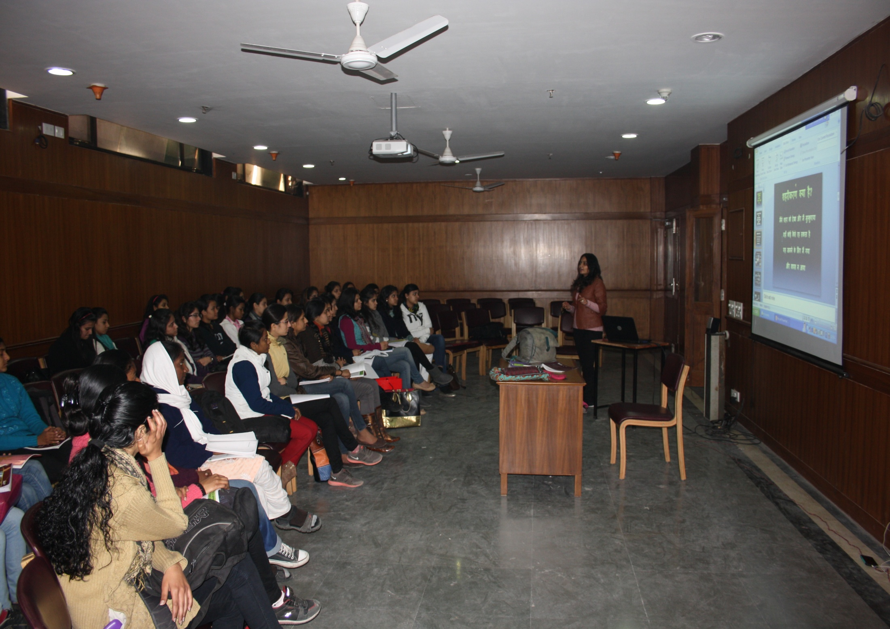

Slide 43
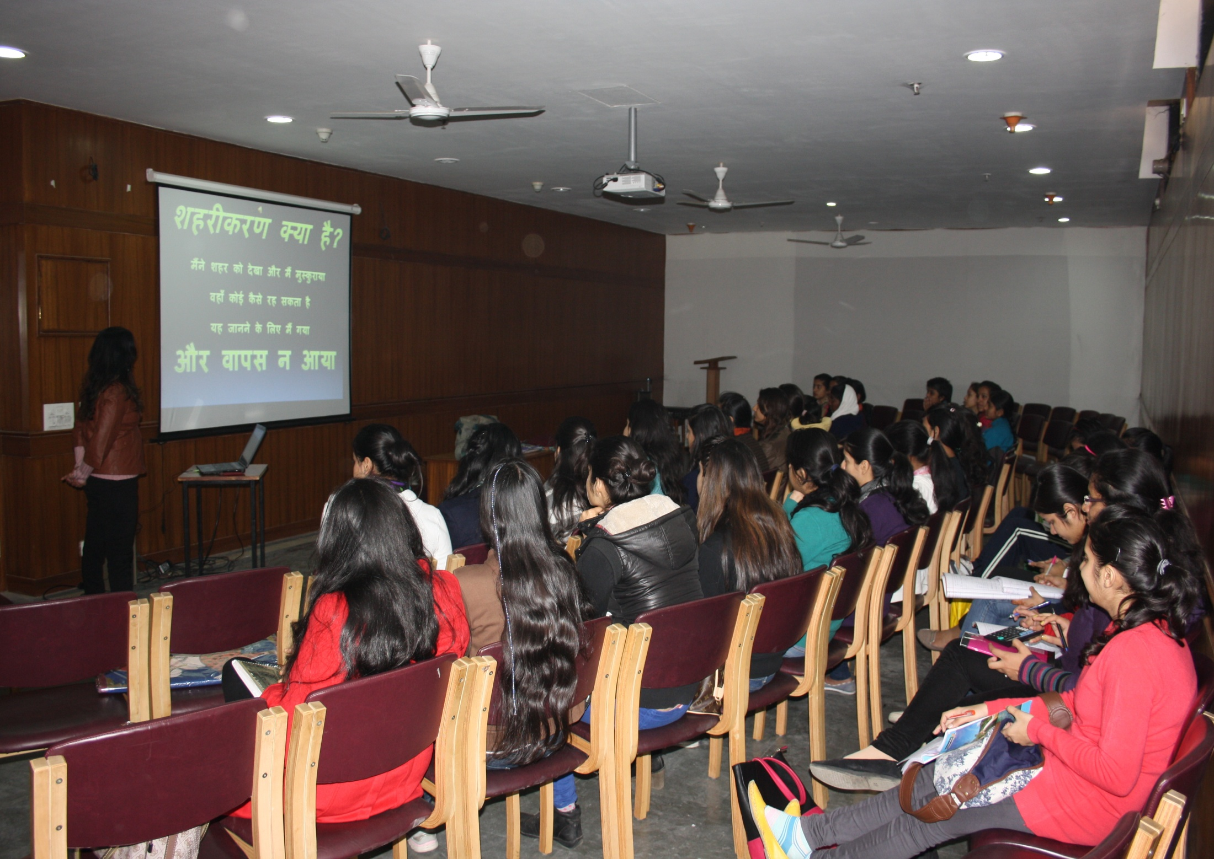

Slide 44
FEEDBACK
An informal feed back from students is taken on regular basis.
Students fill feed-back form available on college web-site.

Slide 45
EVALUATION OF TEACHER
Evaluation by students is done which helps not only teachers to improve on themselve but also to students to judge ojectively.
Teachers meet parents in PTSA and get a direct feed back from them.

Slide 46
LIBRARY AS LEARNING RESOURCE
Very rich library & computer equipped in each aspect.
Books on each subject in multiple copies are available.
Number of Magazines ,Journals,News papers (Hindi & English) are available. ( Anbhay sancha,Vagarth,Sahitya-amrit, Hans,Kadambini,India Today.)
Book Bank facility for needy students.
Granthavalies (complete work) of eminent writers and all kinds of Dictionaries,Encyclopedias,Thesarus,Mythological Dictionaries are available in Reserve section.
Computer Facilities with updated softwares in Hindi & internet is available in the library.(Troodon library software)
The library has reading cabins besides reading room for teachers and students.

Slide 47
STUDENTS MENTORING AND SUPPORT
MENTOR WARD SYSTEM
Classes are divided into groups of 16-20 students each.
Teachers are available twice in a week as indicated in their time-table and students are informed accordingly.
Students meet the teacher on individual basis also to discuss any problem with them.Confidentiality is maintained.
Teacher-in-charge remains in touch with students where they can share their problems if any.
Besides the assigned teacher,students can go to any other teacher also,where they feel more comfortable.

Slide 48
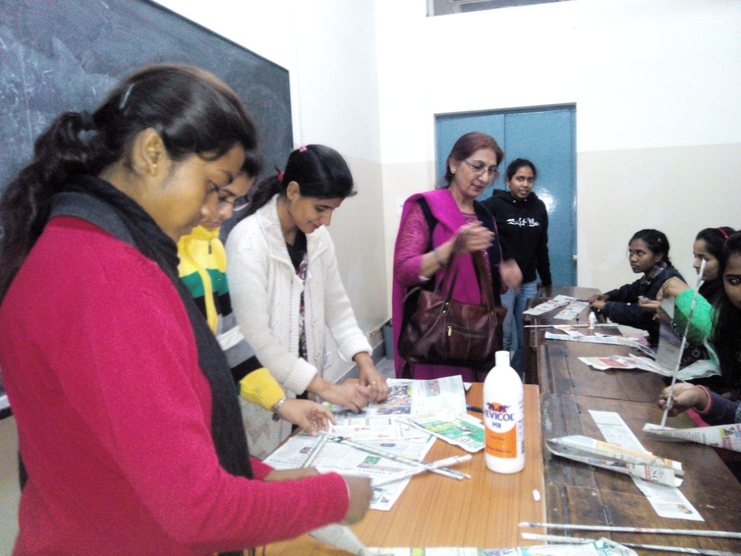

Slide 49
Best Practices

Slide 50
Contribution to college Magazine
( Hindi Section)
75% contribution of Hindi Hons. students in year 2015-2016
88% contribution of Hindi Hons. students in year 2016-2017

Slide 51
Out reach programs
Educating underpriviledge students in their neighbourhood.
Changing the attitudes of the community around them through their own transformed personality.
Volunteering for the Blind Foundation.
Distribution of sanitary napkins to slum area near Patel-Nagar,New Delhi.

Slide 52
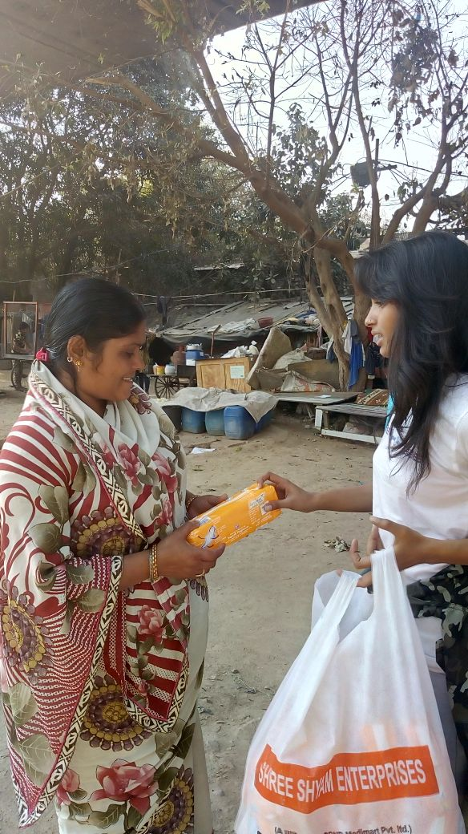
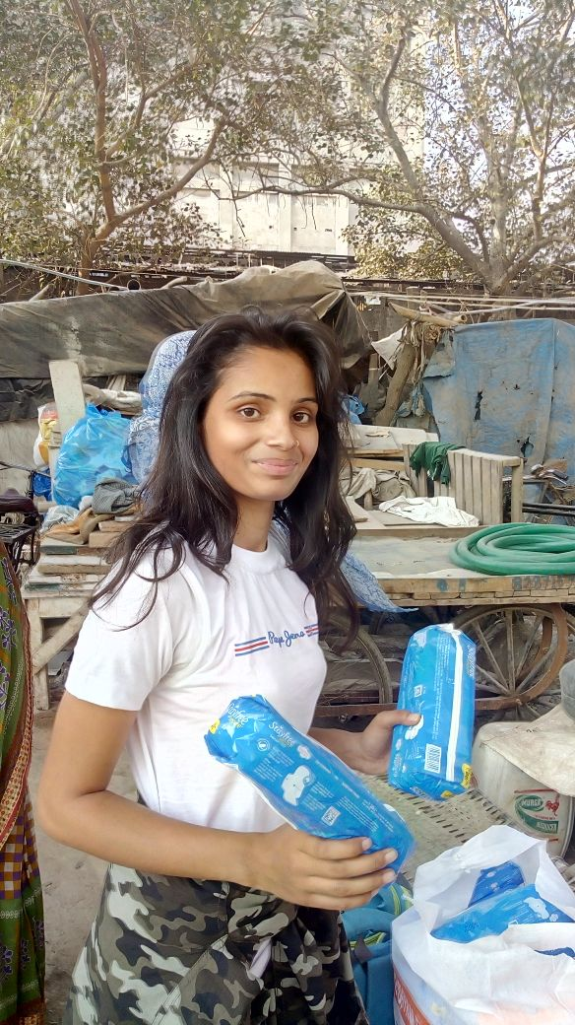
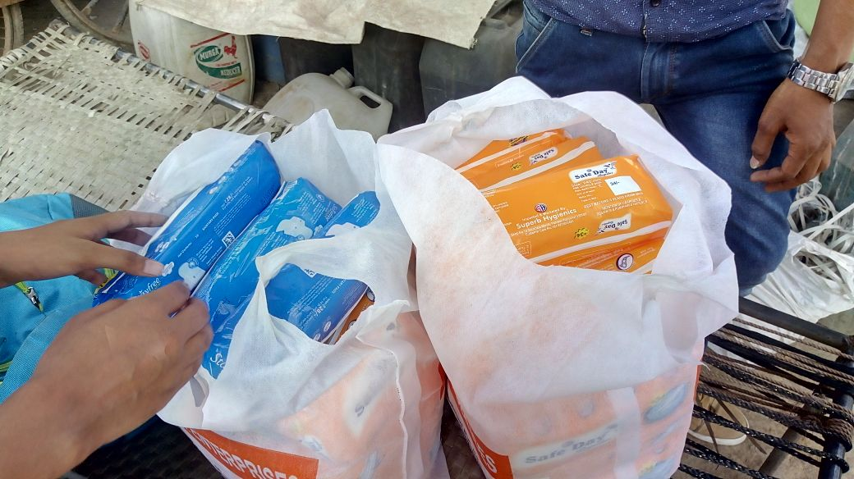
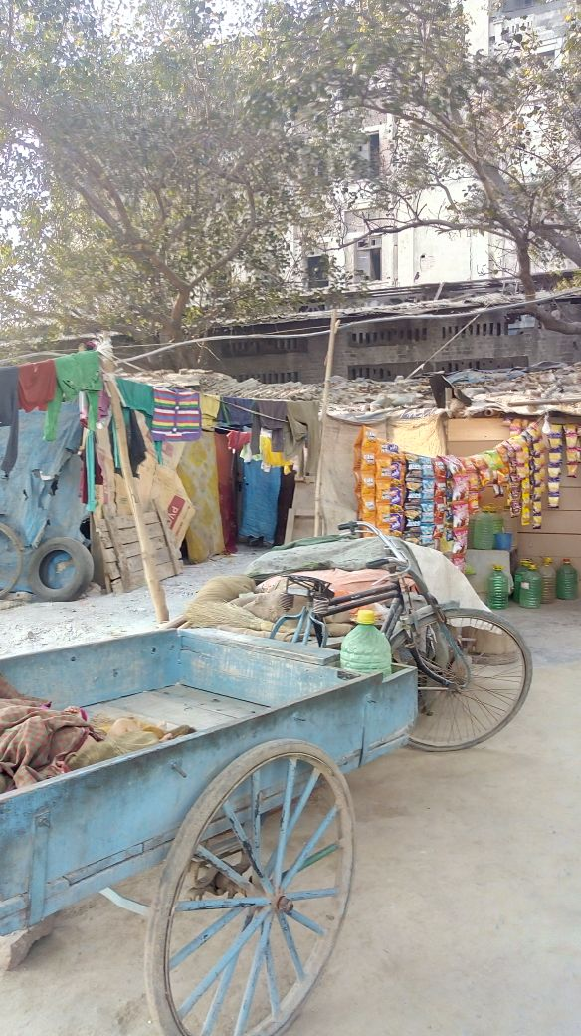
Outreach Programme

Slide 53
REMEDIAL CLASSES
2015-16
We used to take two remedial classes per week for those students who were weak in studies and required extra attention.Due to lack of support of these were formally stopped.
Informally we are still taking remedial classes with weak students and sports students.
MA students also get help and guidance by the dept.

Slide 54
ENVIORNMENT AND LITERATURE
By learning text related to the nature, students become enviornment friendly and develop sensitivity.
While working for the various societies of the college, students make society aware about the enviornmental issues, like cleanliness, hygiene, water scarcity and disposal of e-waste.
Extra efforts to save enviornment by switching off fans and lights while leaving classrooms.
Organize workshops on making best out of waste etc.

Slide 55
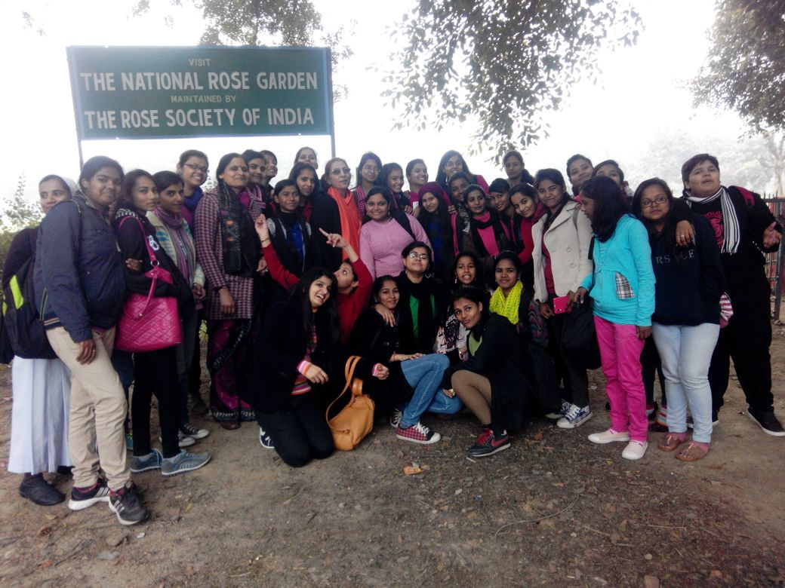
Enviornmental awareness – Naturewalk-2015

Slide 56
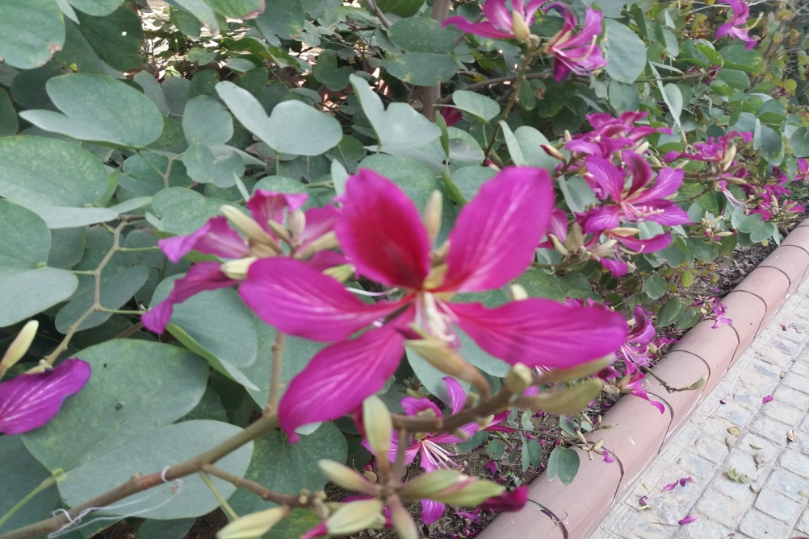
NATURE WALK
Students and teachers walk together around the college area to get the feel of nature and its charging moods during spring season e.g. Rose garden,Nehru park Smriti Vatika, Vanasthali etc.
e.g. ‘Pallav- Sinchan’

Slide 57
STUDY CIRCLE
A small group of teachers from college and from outside meet once in a semester and discuss some newly published book or relevent topic.

Slide 58
BOOK BANK
Needy students can borrow books & reading material from the Book-Bank of the Department.

Slide 60
EVALUATION PROCESS AND REFORMS
Active participation in class
Paper presentations
Power point presentation
Group discussions
Open book tests
Projects
Home assignments & Class-Tests
Multiple - choice test
Syllabus based quiz

Slide 61
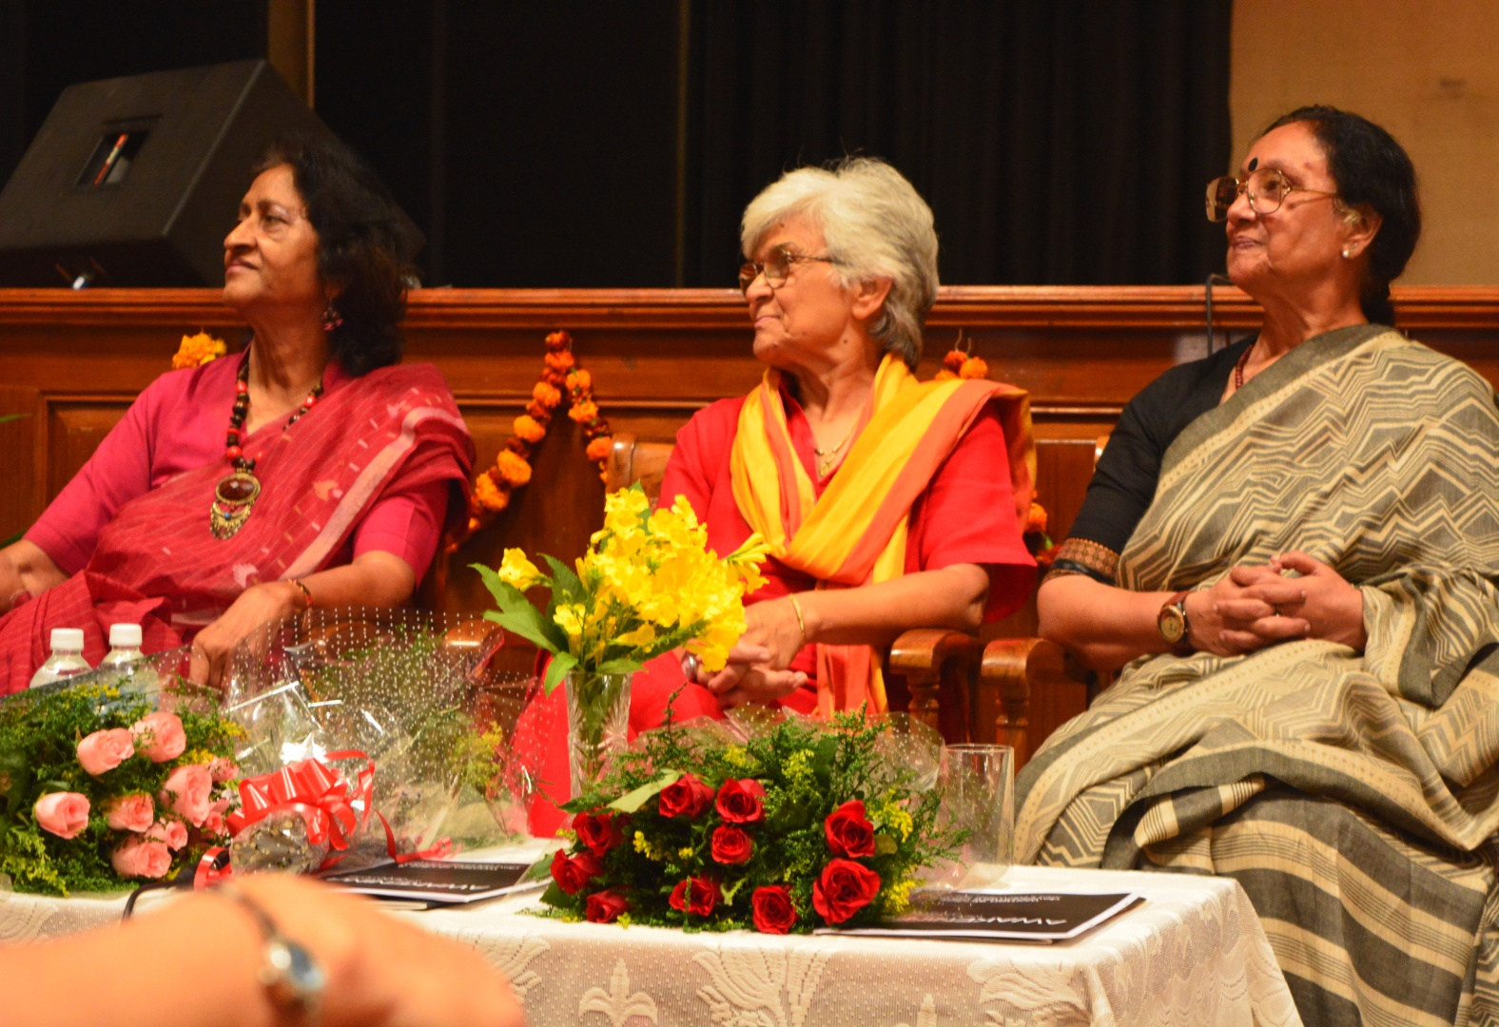
EMINENT ACADEMICIANS
MANY EMINENT ACADEMICIANS FROM VARIOUS FIELDS WERE INVITED IN VARIOUS SEMINARS & WORKSHOPS

Slide 62
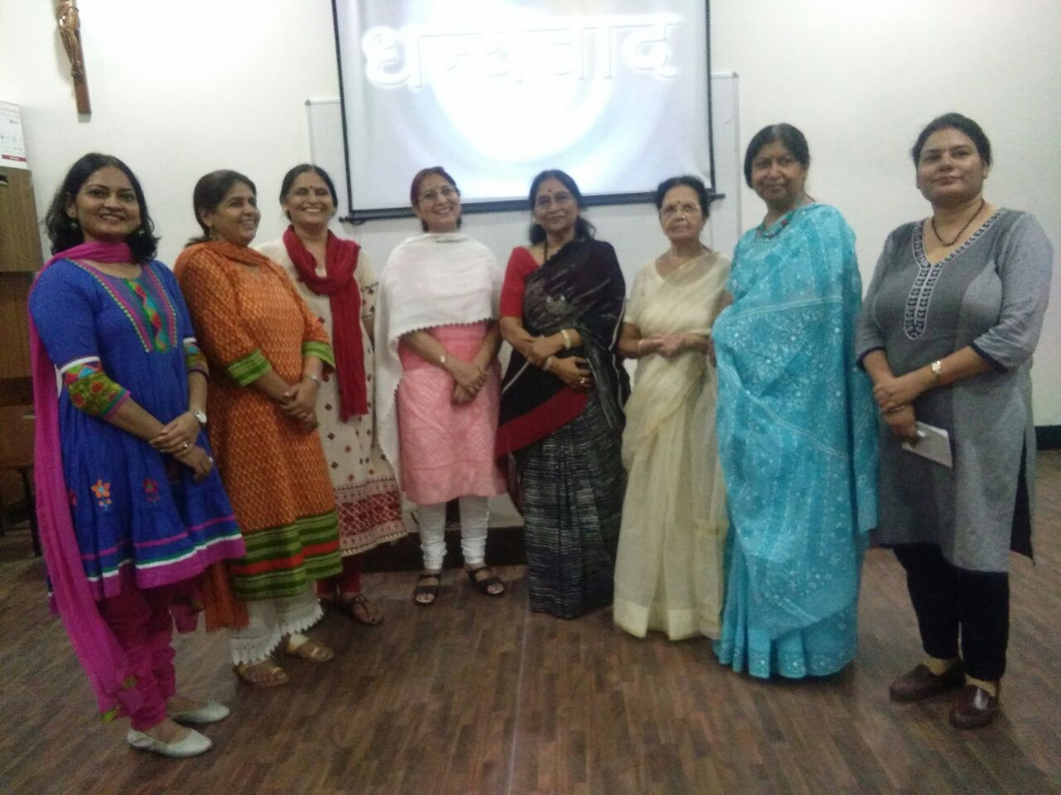

Slide 63
Chitra Mudgal
Kamala Bhasin
Dr. Kamal Kumar
Dr. Prem Singh
Dr. Lakshmi Shankar Bajpai
Prof. Sunita Jain
Prof. Kamala Jain
Prof. Javarimal Parakh
Prof. Sudha Singh
Dr. Ravi Kant
Mr. Amitaabh Srivastava
Prof. Mukesh Garg
Prof.Poorranchan Tandon
Prof. Ritarani Paliwal
Dr.Indu Aneja

Slide 64
Seminar,Workshops,Conferences organized
One day seminar on ‘Gender sensitization’
One day seminar on ‘Media Cinema and Market forces’
Annual departmental festival ‘Sahityotsava’ is organized every year.It includes inter-class / Inter-college Debate, Poetry,Creative Writing, Quiz and folk-dance competitions..
Talk on women in Jain & Buddha Philosophy.
( Poetry recitation and Interactive session )
Talk on Uttar-Madhya kaal ( poetry of 17th to 19th century)
Hindi – Divas
( A literary festival )
One day workshop based on PERSONALITY DEVELOPMENT followed by interactive session in collaboration with CHETNA (NGO)
11th September 2017

Slide 65
EXTRA CURRICULAR ACTIVITIES ARRANGED BY THE DEPT.
Orientation
College assembly
Fresher’s welcome
A competition of Patriotic Songs organized by the dept. since 2015
Movie watching ‘DANGAL’ & ‘PADMAVAT’
Crafts Workshop Exhibition ( BOW )
Hindi Divas ( with various literary and cultural competitions for the students and Administrative staff )
Educational trip to Eco adventure park & Amritsar
March-Past by students and teachers.
Farewell
Montage ‘18 : Inter- College Hindi Debate
Topic : Is imagination necessary for Historical Movies?
16^{th february 2018}
Inter- college quiz competition
27th march 2018

Slide 66
GOLDEN JUBILEE EVENTS
Presentation of VARIOUS FOLK-DANCE –FORMS OF RAJASTHAN based on the theme- CULTURAL UNITY IN DIVERSITY OF INDIA.
In collaboration with SAHITYA KALA PARISHAD, NEW DELHI.
27th September 2017.
‘UNTITLED’ – Solo Play by renowned theatre and film personality LUSHIN DUBEY based on Vijay Daan Dethas story and Dario Fo’s Medea , Directed by Arvind Gaur , ASMITA THEATRE
25th October 2017.
A GRAND ALUMANI MEET CELEBRATION
approx. 40 alumani from the batches of past 30 years participated
24th February 2018 .
One day seminar
TOPIC - WOMEN ISSUE IN CONTEMPORARY CONTEXT
16th march 2018

Slide 67
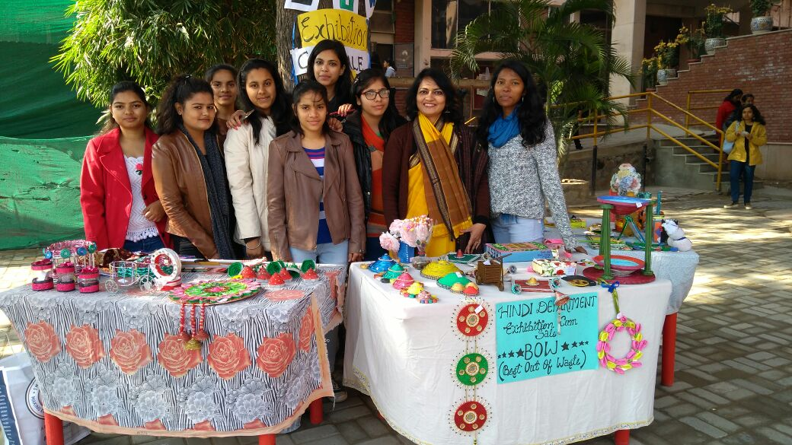
BEST OUT OF WASTE
BOW SALE
An Initiative by Hindi hons students to protect Enviornment - 2016

Slide 68
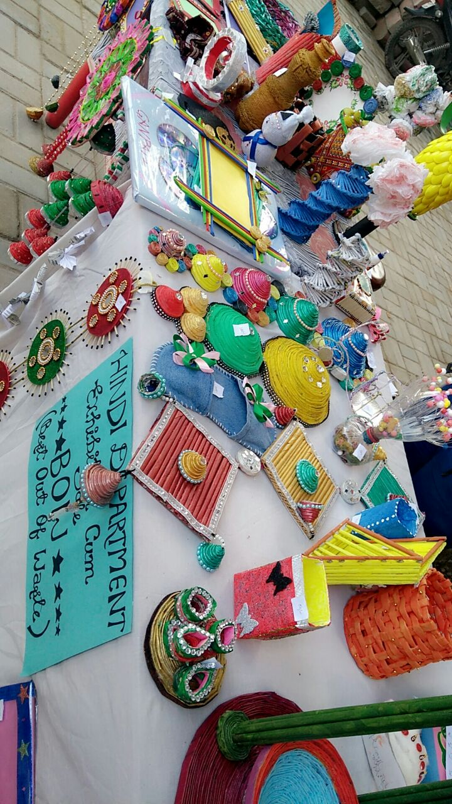
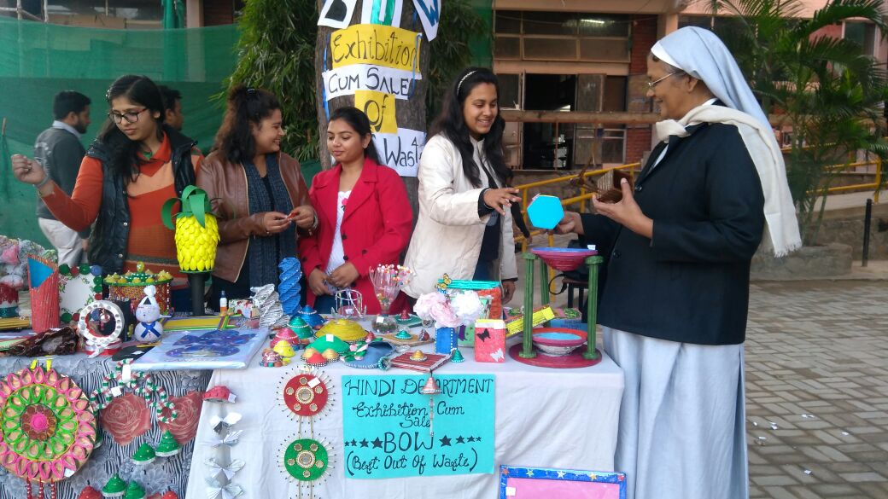
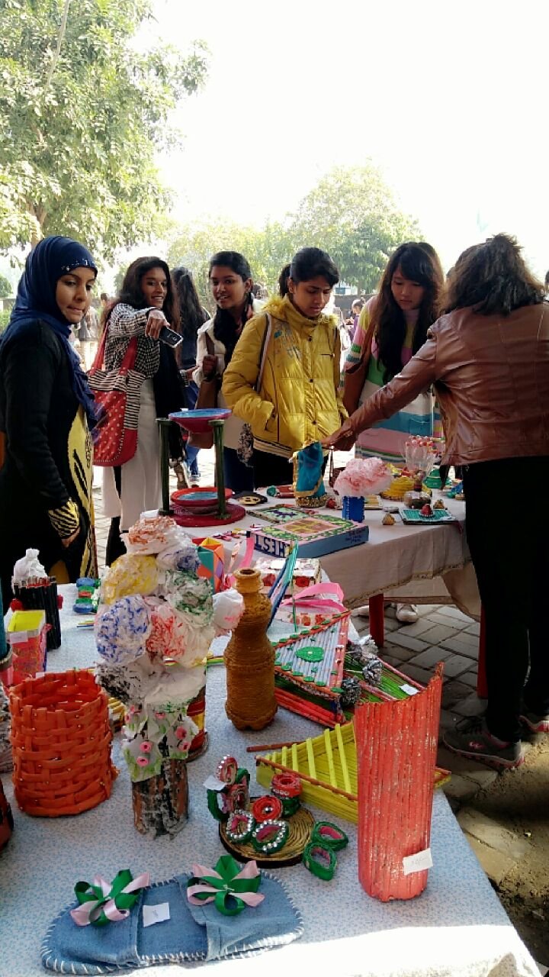
“BOW” SALE & EXHIBITION (feb-2017)

Slide 69
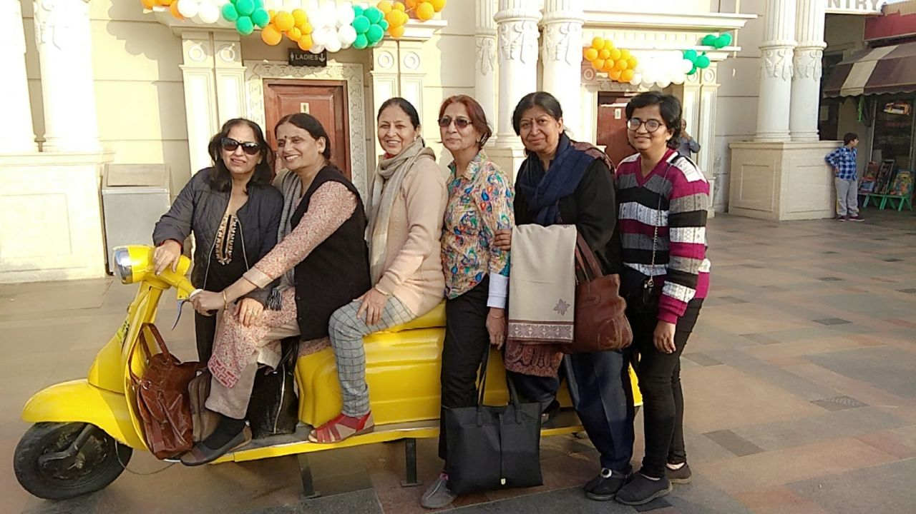
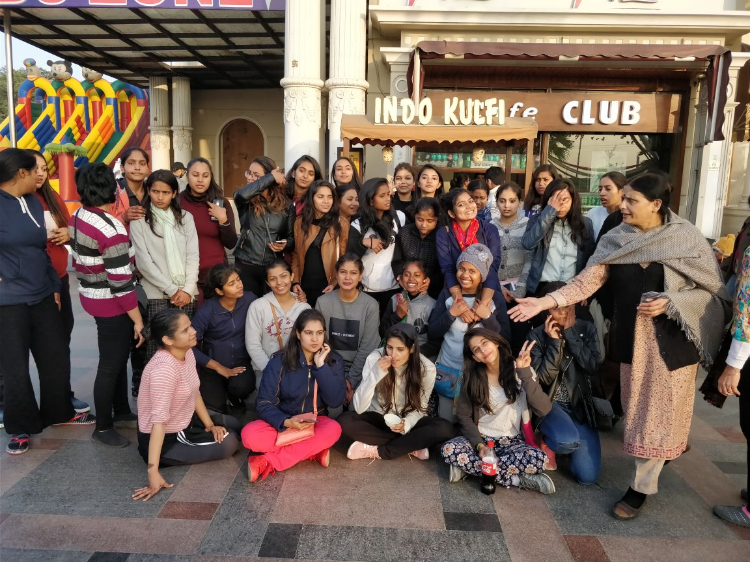
Educational trips
& picnics
AMRITSAR

Slide 70
Adventure island
Eco – adventure park
Mussorie
Akashar dhaam
Visited to nsd
Aravalli biodiversity park
Nature walk to rose
garden, chanakyapuri

Slide 71
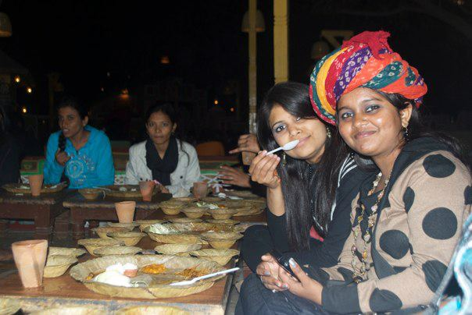
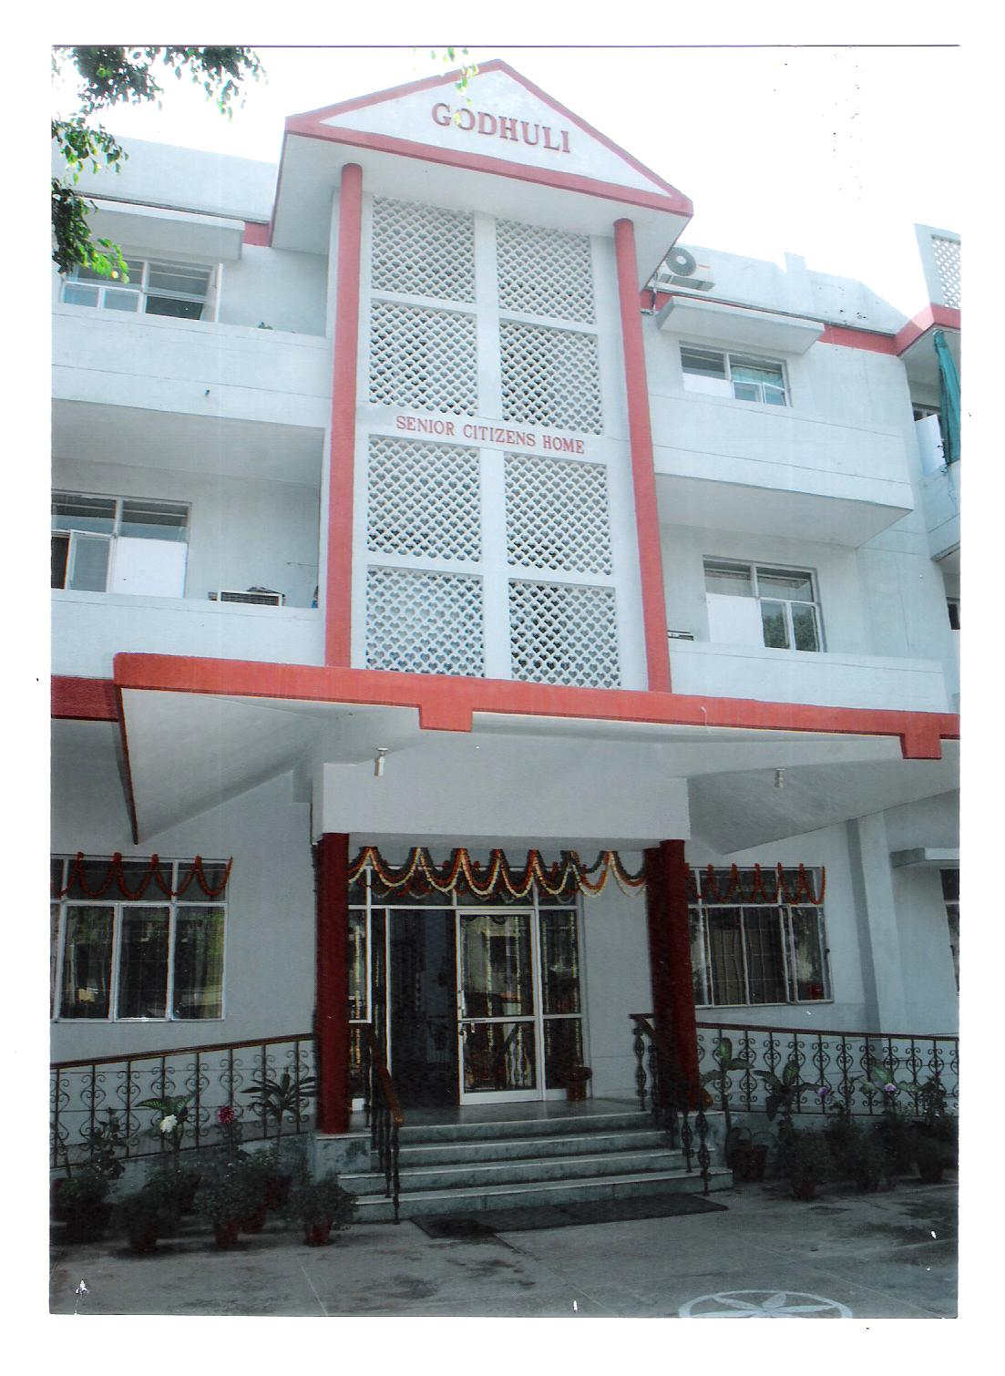
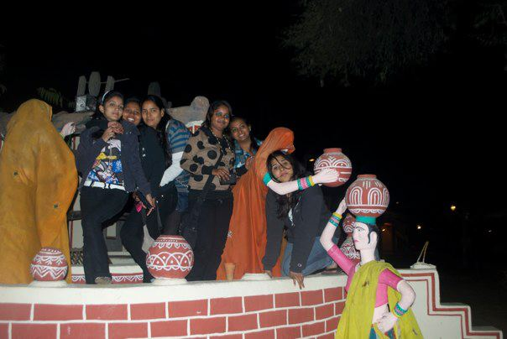
EDUCATIONAL TRIPS
MATHURA, VRINDAVAN, JAIPUR, MUSSORIE, AMRITSAR…….
JAIPUR
VRINDAVAN

Slide 72
Participation in Institutional Responsibility
YEAR | NSS | JMCEP | WSC | NCC | PEACE | GREEN | ANY OTHER
1ST YEAR | 5 | - | 26 | 10 | - | 6 | 10
2ND YEAR | 14 | - | 14 | 4 | - | 6 | 7
3RD YEAR | 12 | - | 11 | 8 |  | 5 | 14

Slide 73
Awards / Recognition received by the students
 | LITERARY & CULTURAL Inter departmental competitions | LITERARY & CULTURAL Inter college competitions | SPORTS UNIVERSITY LEVEL | SPORTS STATE LEVEL | SPORTS ZONAL LEVEL | SPORTS NATIONAL LEVEL | SPORTS INTERNATIONAL
W I N N E R S | 22 | 17 | 11 | 12 | 1 | 3 | 1

Slide 74
MERITORIOUS STUDENTS
Sr.Renu 2017- 1ST Position in college
Best student in all 3 years.
Gulafsha 2017 – 2nd Position in college
Shivangi Singh 2016 –1ST Position in college
Best student in all 3 years.
Kumkum 2016 – 2nd Position in college

Slide 75
SPORTS : ACHIEVEMENT AT INTERNATIONAL LEVEL
INTERNATIONAL WOMEN HANDBALL CHAMPIONSHIP-2015-16
Pakistan
2nd Position HEMA
INTERNATIONAL 5TH ASIAN BEACH GAMES- 2016
Vietnam
Participation HEMA
ASIA RUGBY - GIRLS CHAMPIONSHIP – NOVEMBER - 2017
( Youth Olympics - Asia Qualifier ) DUBAI ( U.A.E.)
4TH POSITION IN ASIA SULTANA & PRIYA
PARIS WORLD GAMES – 2017
( France Tournament ) FRANCE
5TH POSITION SULTANA
INTERNATIONAL WOMEN HANDBALL CHAMPIONHIP- 2019
Hongkong
1st position REKHA

Slide 76
SPORTS: ACHIEVEMENTS AT NATIONAL LEVEL
All India Kabaddi Tournament , BENGALURU-22nd - Aug-2nd Sep.2016
IIIrd position PUSHPA & PRIYANKA
MCC National Handball competion,DELHI OLYMPICS-2017
IIIrd position AARTI KUMARI
Ist position ANITA SHARMA
National level Baseball cricket -2017-18
Ist position SAKSHI
Tug of War – Open National – Jan. 2018
Iind position SAYYONI

Slide 77
STUDENTS PROGRESSION
P.G. to PH.D.
5%
P.G. to M.PHIL. 10%
U.G. to P.G. 70%

Slide 78
PROFESSIONAL TRAINING
B.Ed
Fashion designing
Journalism
Translation
Tourism
Interior Decoraion
Music and Dance

Slide 79
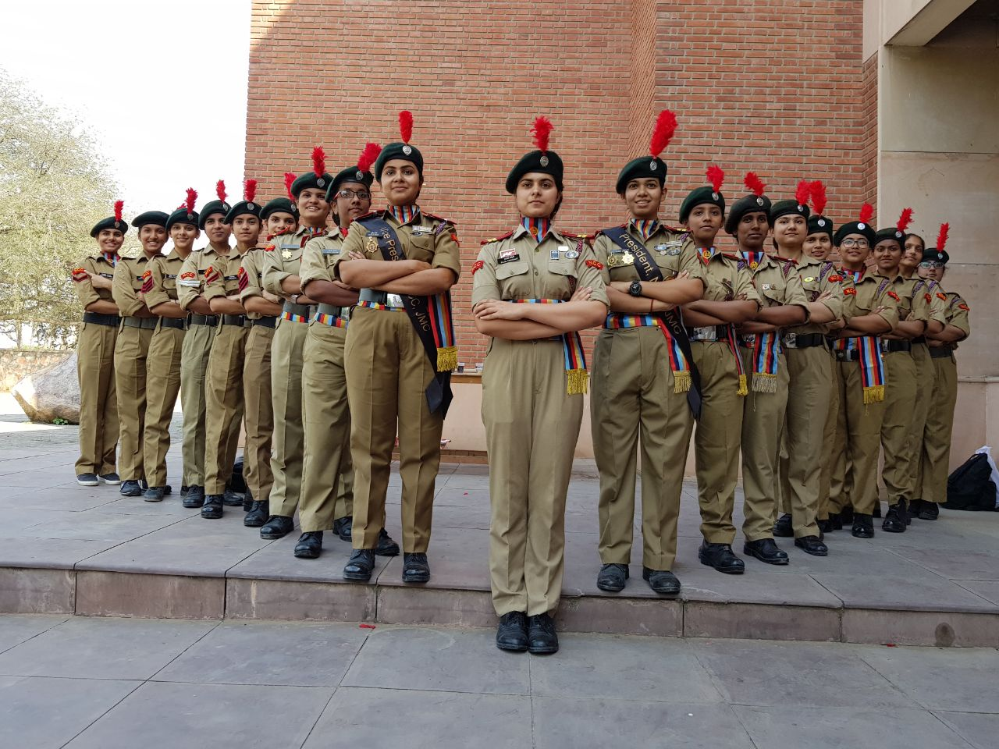
5% STUDENTS CLEARED NET
Defence services & Police : Approx. 5% ( Mostly from NCC )

Slide 80
OCCUPATION

Slide 81
OCCUPATION

Slide 82
Our alumani

Slide 83
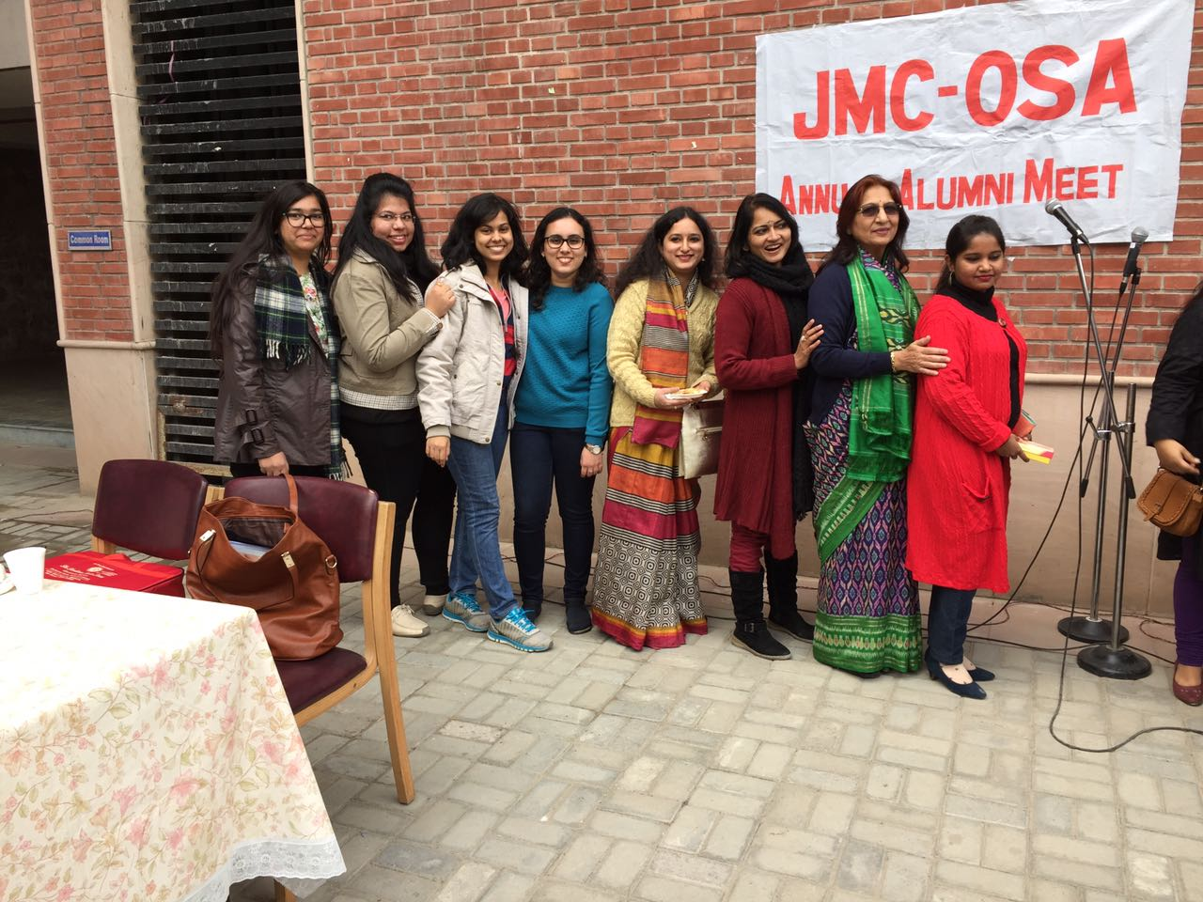

Slide 84
S.N. | NAME | PROFILE
1 | SHAGUN | ASSOCIATE PROFESSOR,SPM.DU
2 | SUNITA DURANGAL | ASSOCIATE PROFESSOR,DR.D.U.
3 | NEELIMA | ASSOCIATE PROFESSOR,ZAKIR HUSSAIN COLLEGE,D.U.
4 | SUJHATA | ASSISTANT PROFESSOR,SHYAM LAL COLEGE,D.U.
5 | SEEMA MAHESHWARI | ASSISTANT PROFESSOR,MAITREYI(ADHOC)
6 | BHARTI | ASSISTANT PROFESSOR,BHARTI COLLEGE,D.U.
7 | ANUPAMA | ASSISTANT PROFESSOR,DR.D.U.
8 | SAPNA GANDHI | ASSISTANT PROFESSOR,JMC,D.U.
9 | MALINI | ST.COLUMBUS
10 | RENU NARULA | DPS,FARIDABAD
11 | POMLY MAHESHWARI | COACHING INSTITUTE,MUMBAI
12 | AKANKSHA | AZIM PREMJI UNIVERSITY
13 | SHEELA SINHA | RAJ BHASHA ADHIKAARI, POWER GRID OF INDIA
14 | VINITA MAHESHWARI | ADMINISTRATIVE .S.OFFICER,AMITY,GURGAON
15 | ANITA VAISHNAV | DIRECTOR,D.P.S.
16 | VINITA PANDEY | WORKING WITH TIMES OF INDIA
17 | MADHURI | SPORTS TEACHER ,DPS, DEHRADUN
18 | PREETI TIWARI | ASSISTANT HINDI OFFICER, INDIAN OIL
19 | JYOTI | DANCE TEACHER, PATHWAYS SCHOOL,GK

Slide 85
UPDATE THE LIST OF ALUMANI

Slide 86
NUMBER OF STUDENTS GETTING FINANCIAL ASSISTANCE
Approx 40

Slide 87
SWOC
STRENGTH
All faculty members are highly qualified and fully committed to their work.
Students are biggest strength because they help us in growing academically , mentally and emotionally.

Slide 88
Despite getting students with low percentage at the time of admission,due to hard work of the faculty, students perform very good and compete with other colleges.
 | CUT-OFF PERCENTAGE FOR ADMISSION TO HINDI HON’S | PERCENTAGE IN GRADUATION
2015-2016 | 58% | 60%-70% = ( 53% RESULT) 70%-80% = (9% RESULT )
2016-2017 | 60% | 60%-70% = (16% RESULT) 70%-80% = (35% RESULT)

Slide 89
INFRA-STRUCTURE & LEARNING RESOURCES
Good infrastructure
Physical Facilities
Most classrooms have projectors and are used for teaching purpose.
Teachers have their personal rooms for tutorials classes and their academic work.
Amphitheatre, Multipurpose Hall,Computer Labs ,Seminar-Halls, Conference Room are big facilities for students activities.
The college has beautiful lawns and big sports field.
Stationary shop,Photocopy facility within college premises are big help for students.
Medical room facility is there for students in emergency.

Slide 90
Strength
Teaching is not confined to the class rooms only.Teachers use creative and innovative methods for teaching literature and go beyond text book.
Through literature we try to make our students more aware of their surroundings, society, human relations and enviornment and thus help them to be good human beings.
Exemplary achievements in Sports by our students at National & International level. Besides taking part in sports these students get good marks.
Sports students are provided extra help by the faculty to catch up with their studies as they miss a lot of classes due to their practice and tournaments.

Slide 91
Weakness
Though under CBCS scheme University provides us various Hindi papers as option in different courses but students don’t opt for Hindi. It has badly affected our workload thus the number of teacher.
Choice is given between English and MIL Hindi communication as Ability Enhancement Compulsory Course under CBCS but Hindi Communication option is not offered to students.

Slide 92
HINDI ‘C’ students have been given choice to do other subjects in lieu of MIL Hindi. It reflects upon the language policy as well as attitude prevalent in society.

Slide 93
Opportunities
Hindi is emerging as a language of business, market, advertising and communication. If Hindi is given its due importance in our society, education system and in jobs then it could be the language of future. Students studying Hindi are getting good openings in Journalism and Mass Communication & other fields these days.
Our department encourages and promotes our students to participate in literary and cultural activities at college & Inter-college level.
We arrange seminars,talks,symposium,workshops,personality development sessions,enviornmental awareness and skill development programme in various fields.
We provide counselling to the students at departmental level and hold value oriented discussions to help them to develop into a good human being and responsible citizen of the country.

Slide 94
Challenges
The biggest challenge is new CBCS system which gives option between English and Hindi to students other than Hindi Hons. It is difficult to motivate students to opt for Hindi Communication Paper as AECC (Ability Enhancement Compulsory Course).
The students we get in the college do not have an aptitude for Hindi language. We have to work hard on their aptitude as well as attitude towards Hindi literature and language. Still we make sure that by the time they leave the college, they start loving the subject with excellent results.

Slide 95
While teaching CTH & Hindi C students we often have to teach them Hindi through English medium.
Our students dont find reading material or translation in Hindi for some of the subjects they opt for.
There are very few teachers who can teach their subject in Hindi medium, therefore, students opting for Hindi medium suffer a lot.
Many students with low percentage at school level are the FIRST GENERATION to reach at this level. It is the biggest challenge for us to bring these students to a higher level and cultivate reading habits.

Slide 96
It is equally difficult to push them to participate in extra-curricular activities for their over all development.
It is difficult to keep balance in class while teaching these students along with some very bright students.
Many students come from a weaker socio-economic background with lack of exposure to various cultural and literary activities. It is a challenge to help them to bloom as an overall confident and developed personalities.
It is difficult for us to organize an educational – trip with all of the students due to their weaker economic back ground or traditional family system.

Slide 97
Future plans
We are planning to conduct a U.G.C. Seminar ( National – level) this year.
We are trying to plan / explore classes for employees of nearby embassies ‘Hindi’ as a foreign language.
Students are being trained in Computer specially in Hindi.

Slide 98
धन्यवाद
धन्यवाद

